Slide 1
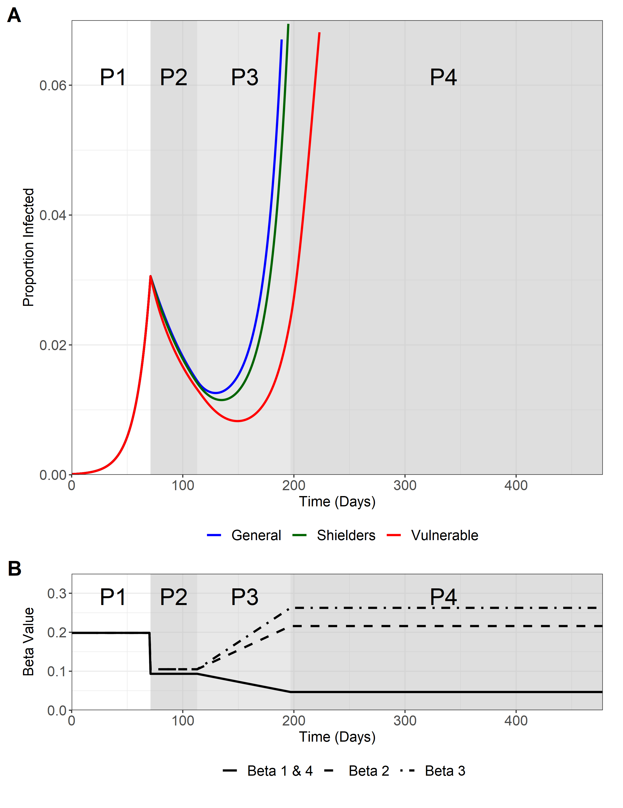
Using baseline parameters SIRS model

Slide 2
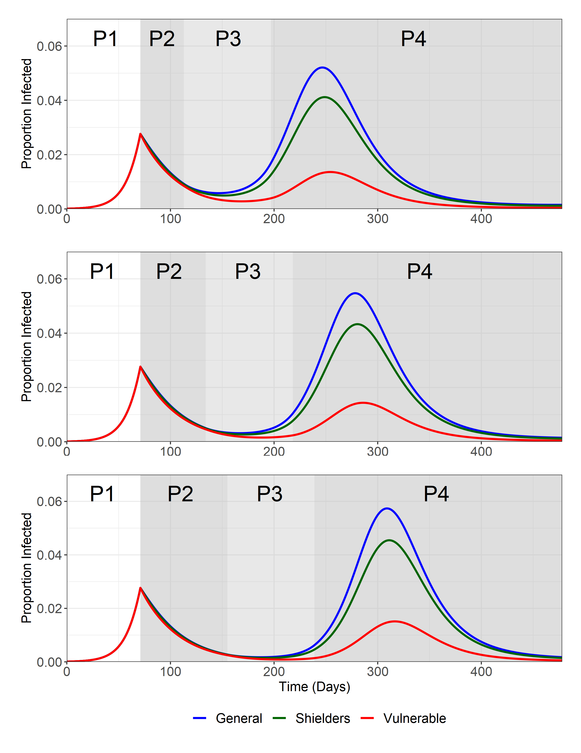
Duration of current lockdown – 6 baseline, 9 and 12
6 Weeks
9 Weeks
12 Weeks

Slide 3
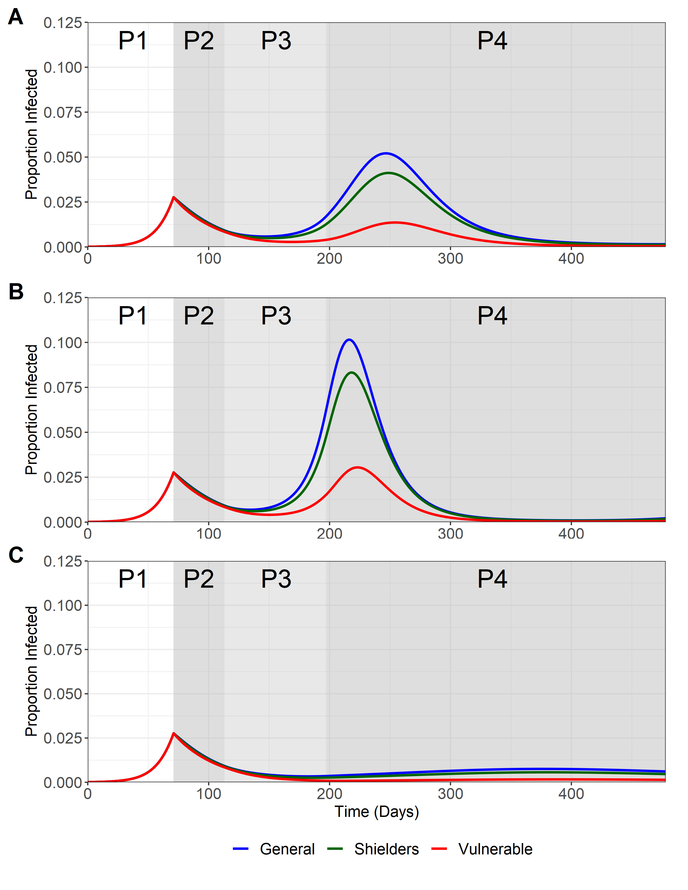
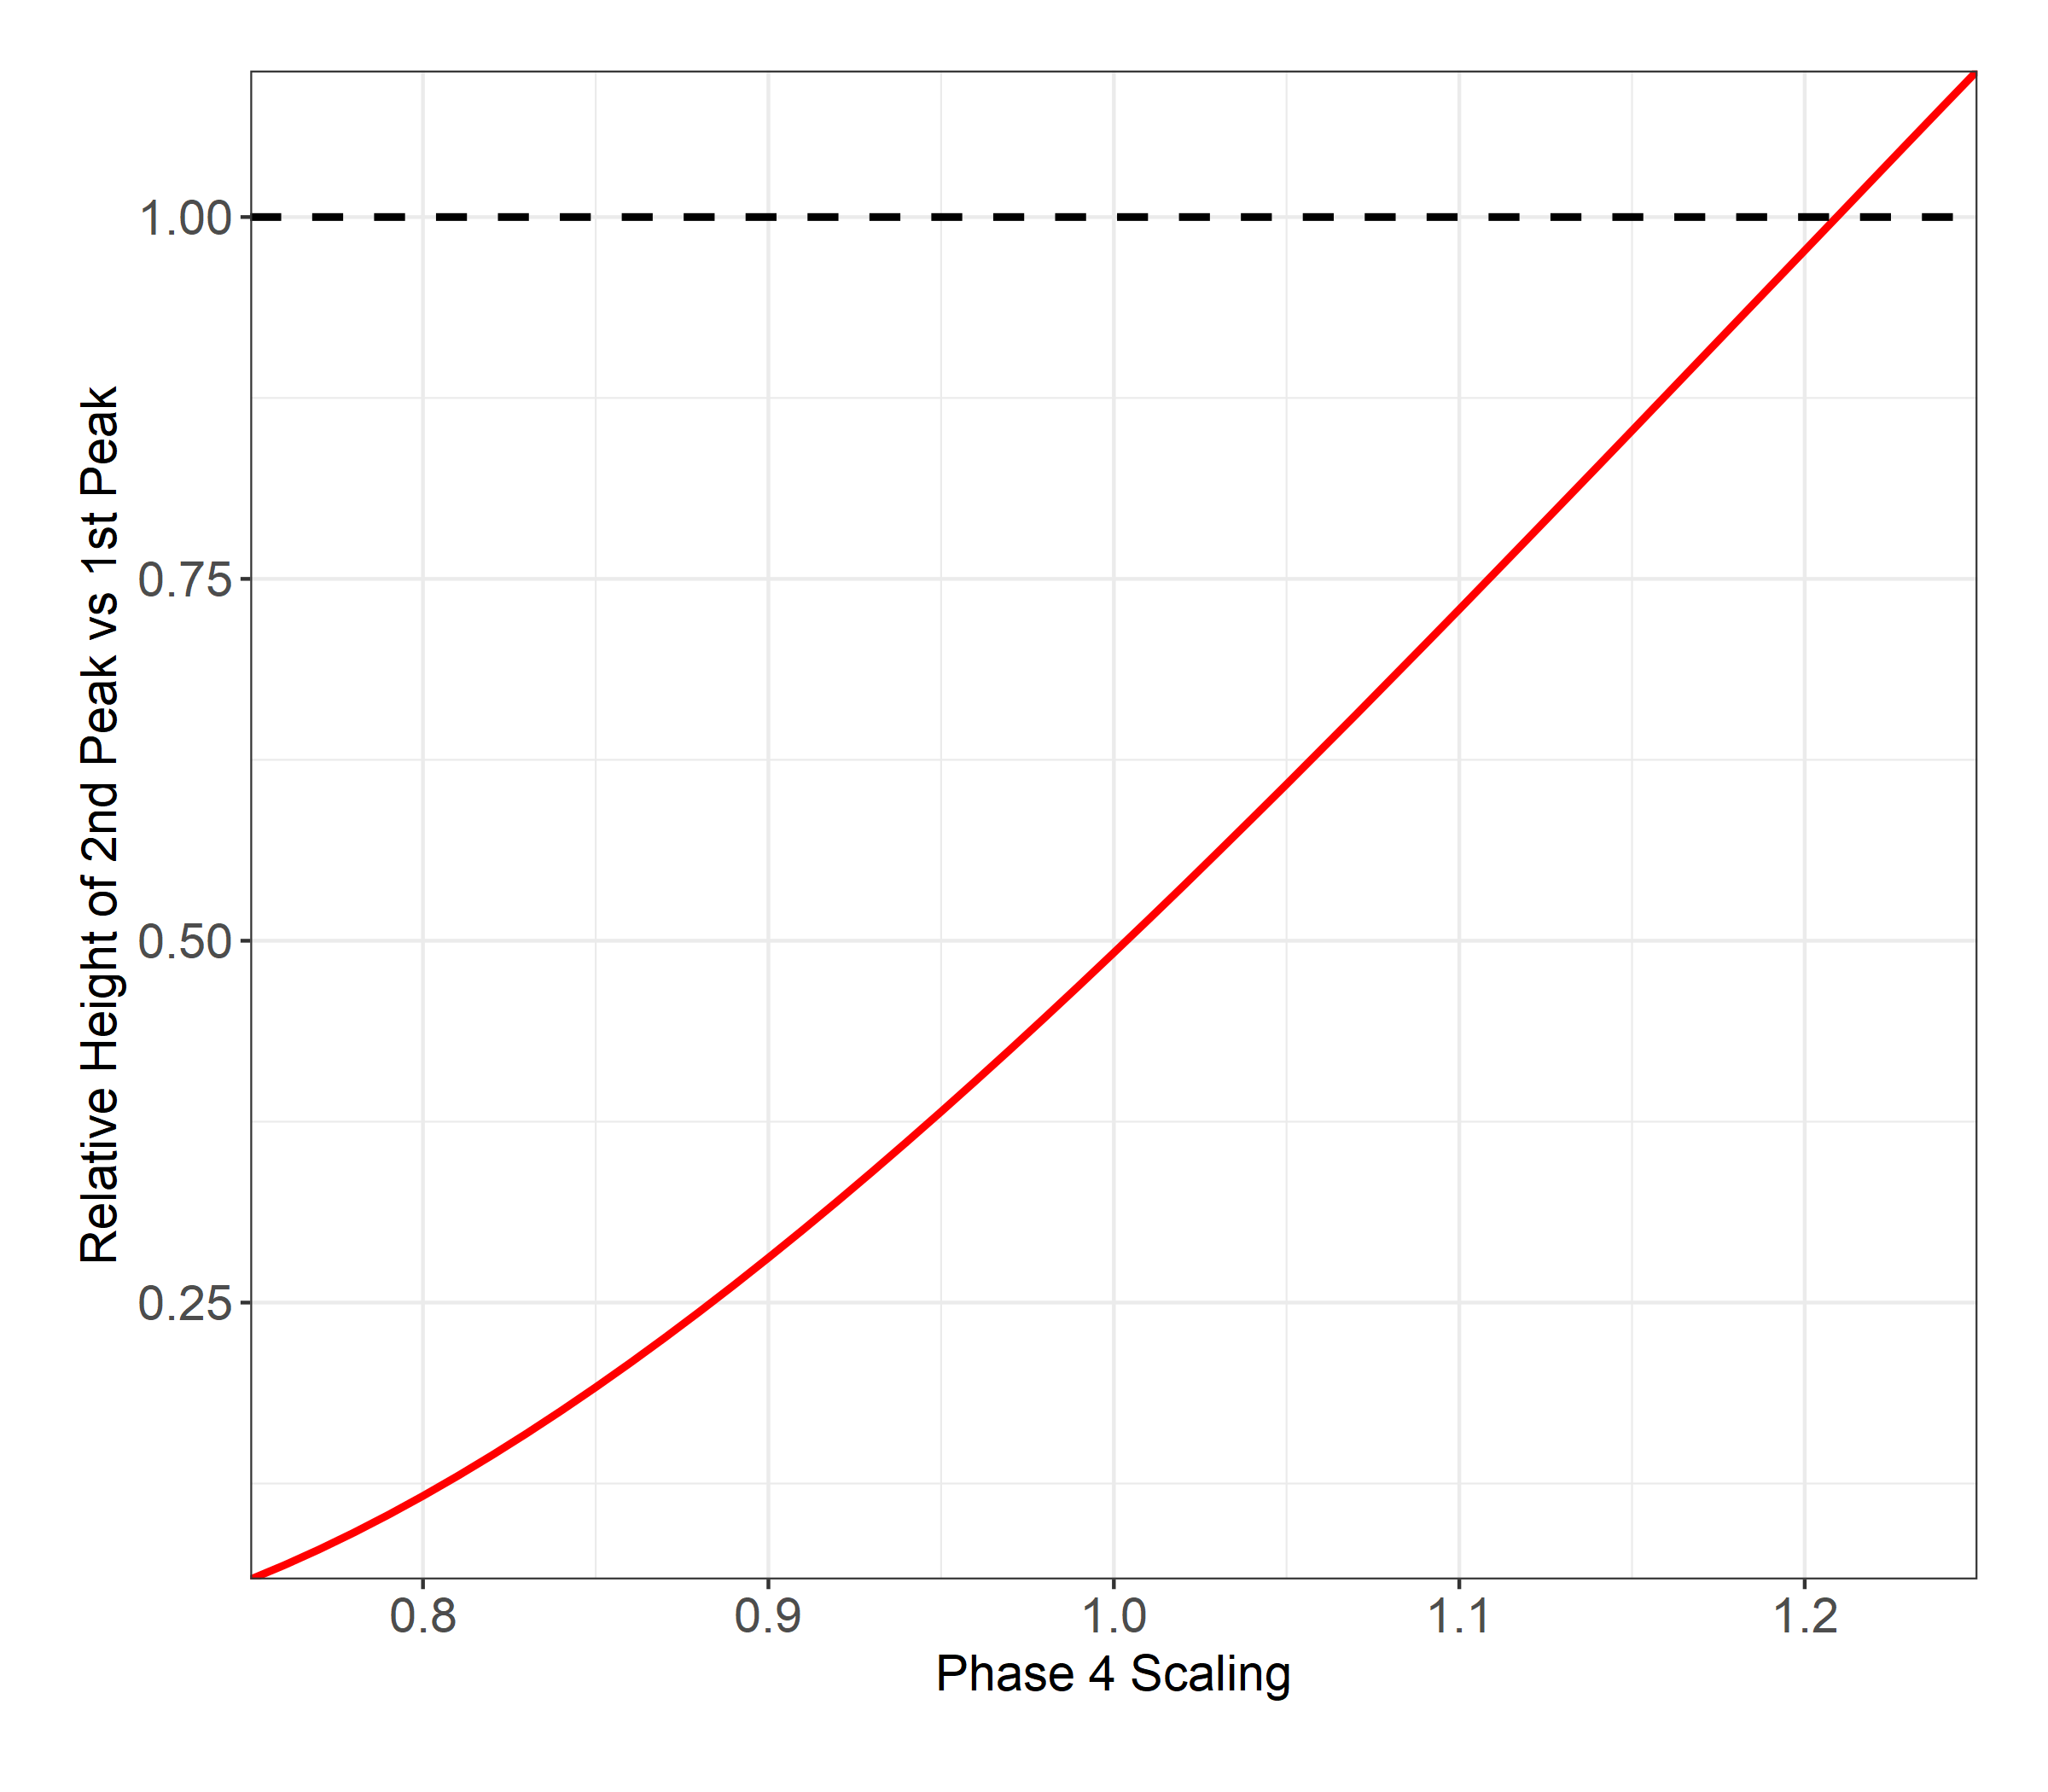
Altering Phase 4 R_e
Baseline
All phase 4 betas were kept at 100% or ranged from 0.75 to 1.25
+25%
-25%

